Slide 1
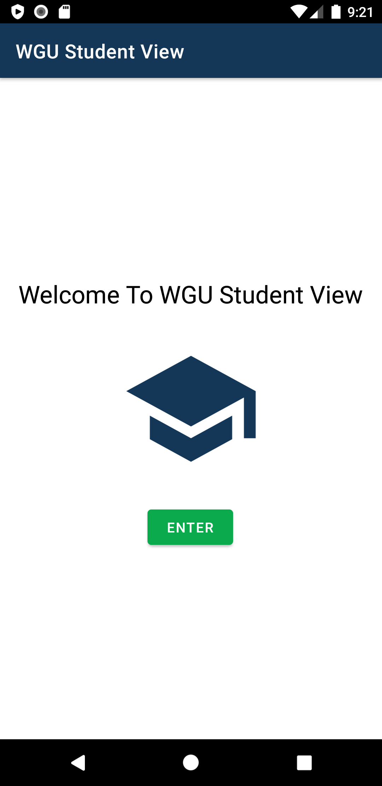
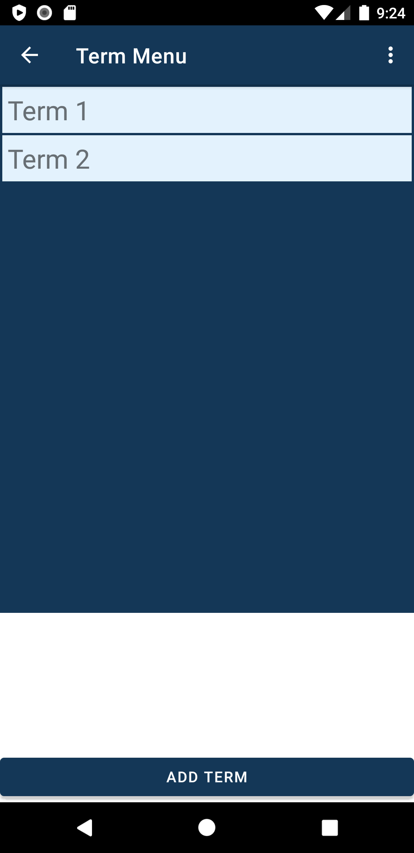
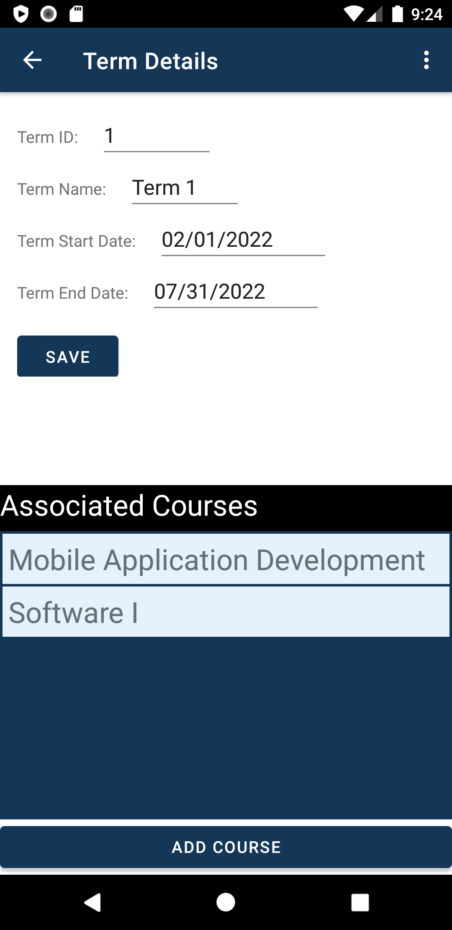
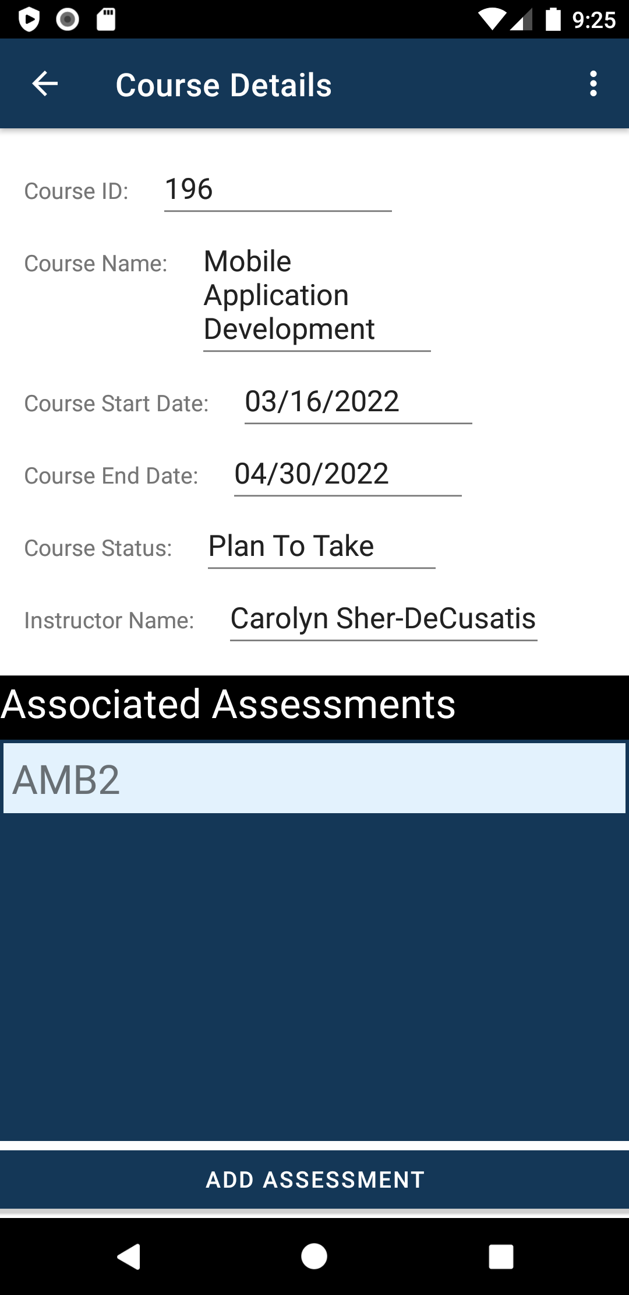
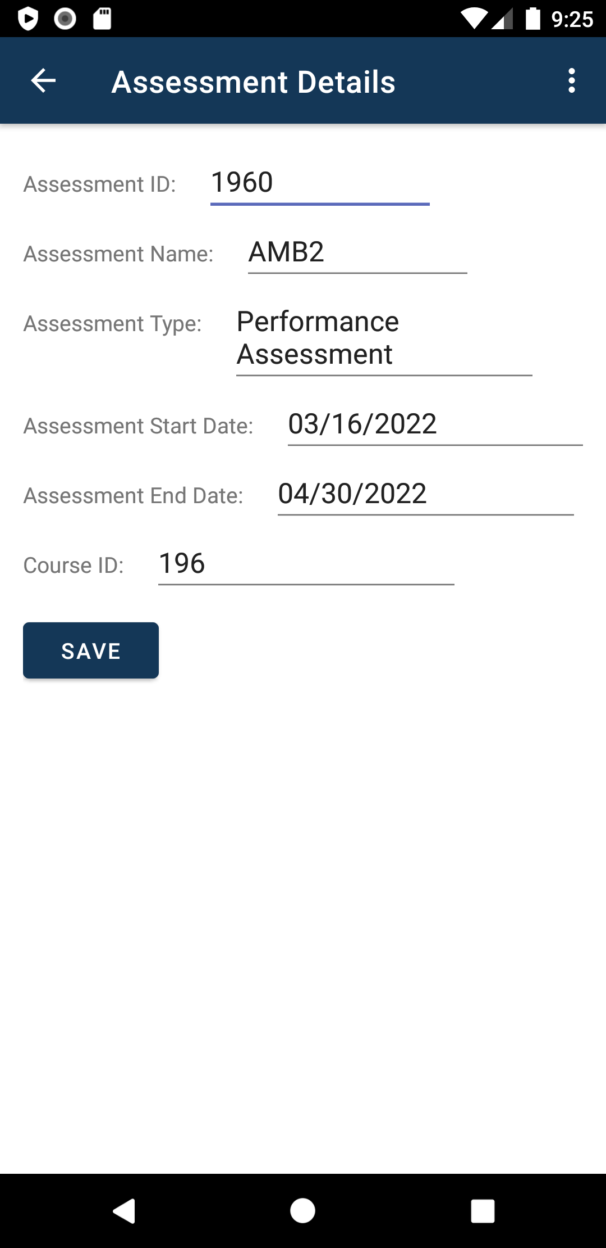
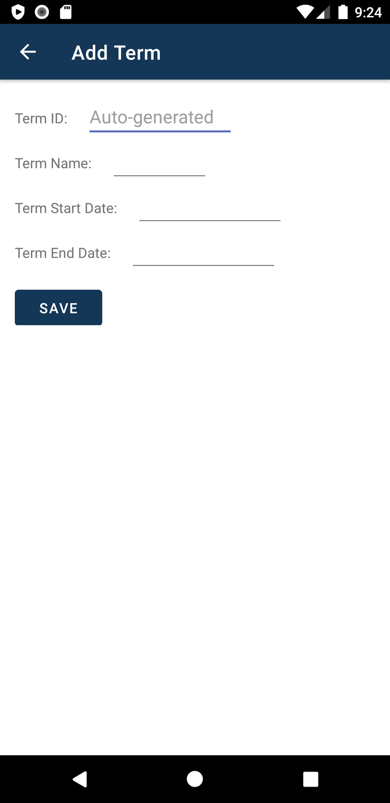
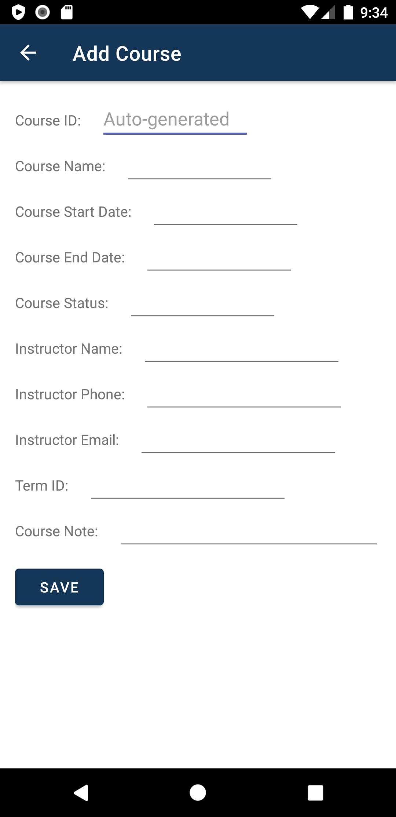
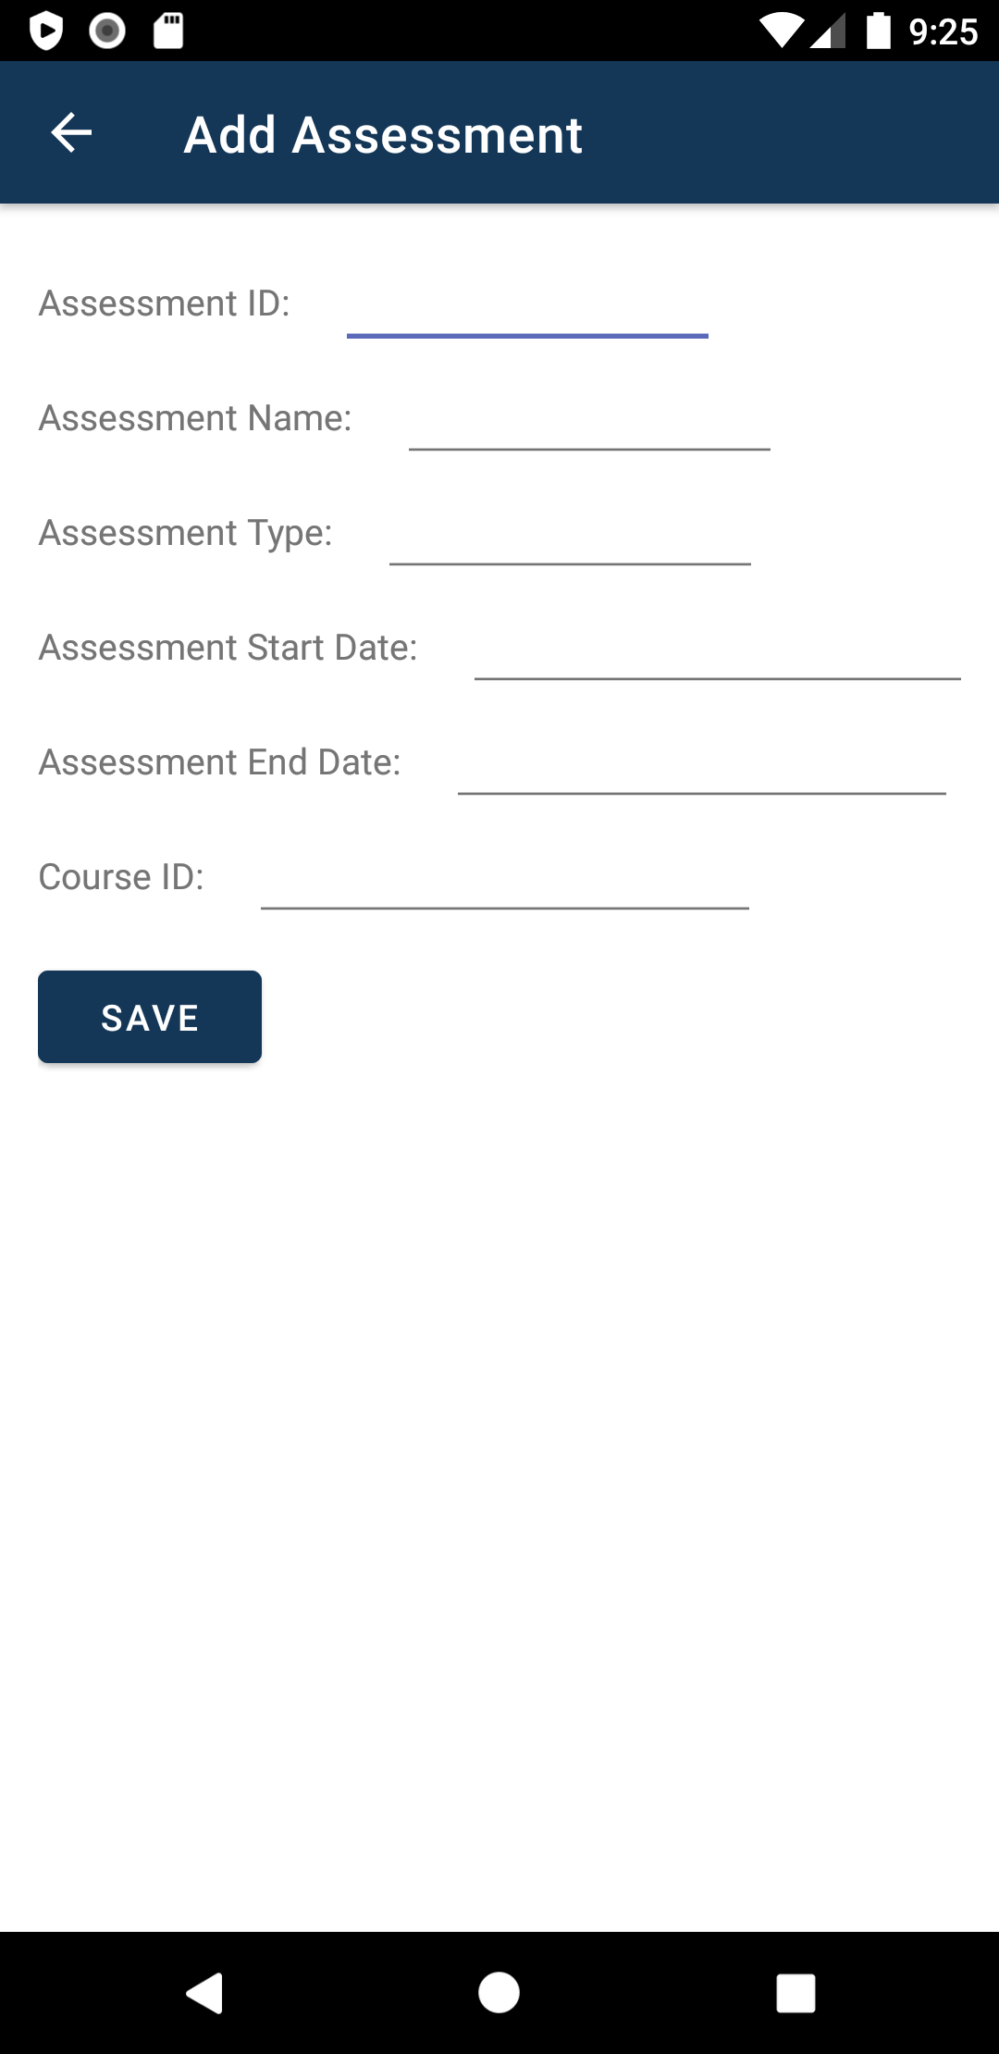
WGU Student View - Storyboard
Selected term opens the term details and associated courses screen
Selected course opens the course details and associated assessments screen
Selected assessment opens the assessment details screen
Add term screen
Add course screen
Add assessment screen
Home Screen – entry point of the app
All terms screen

Slide 2
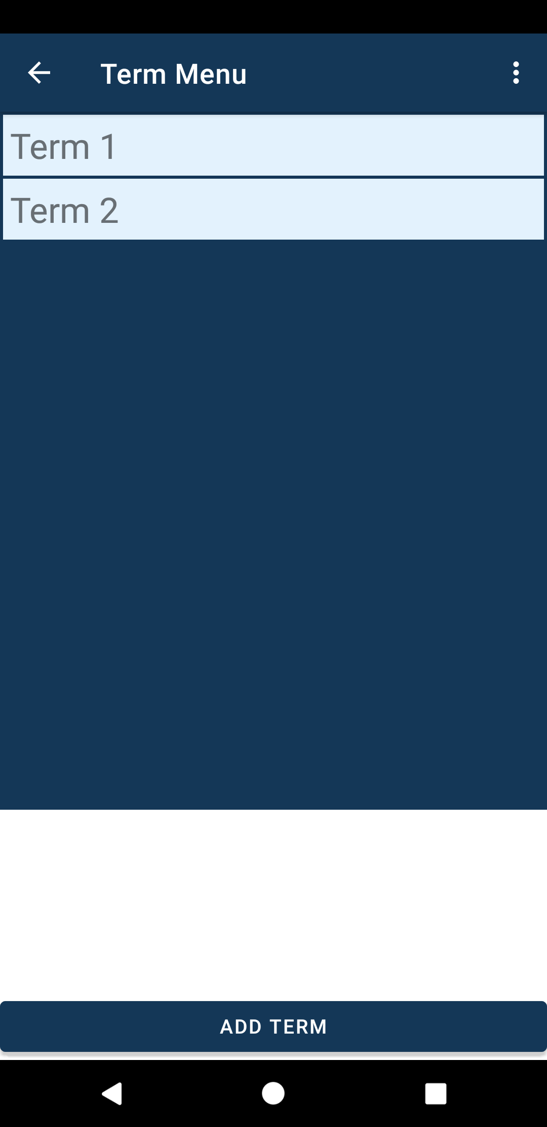
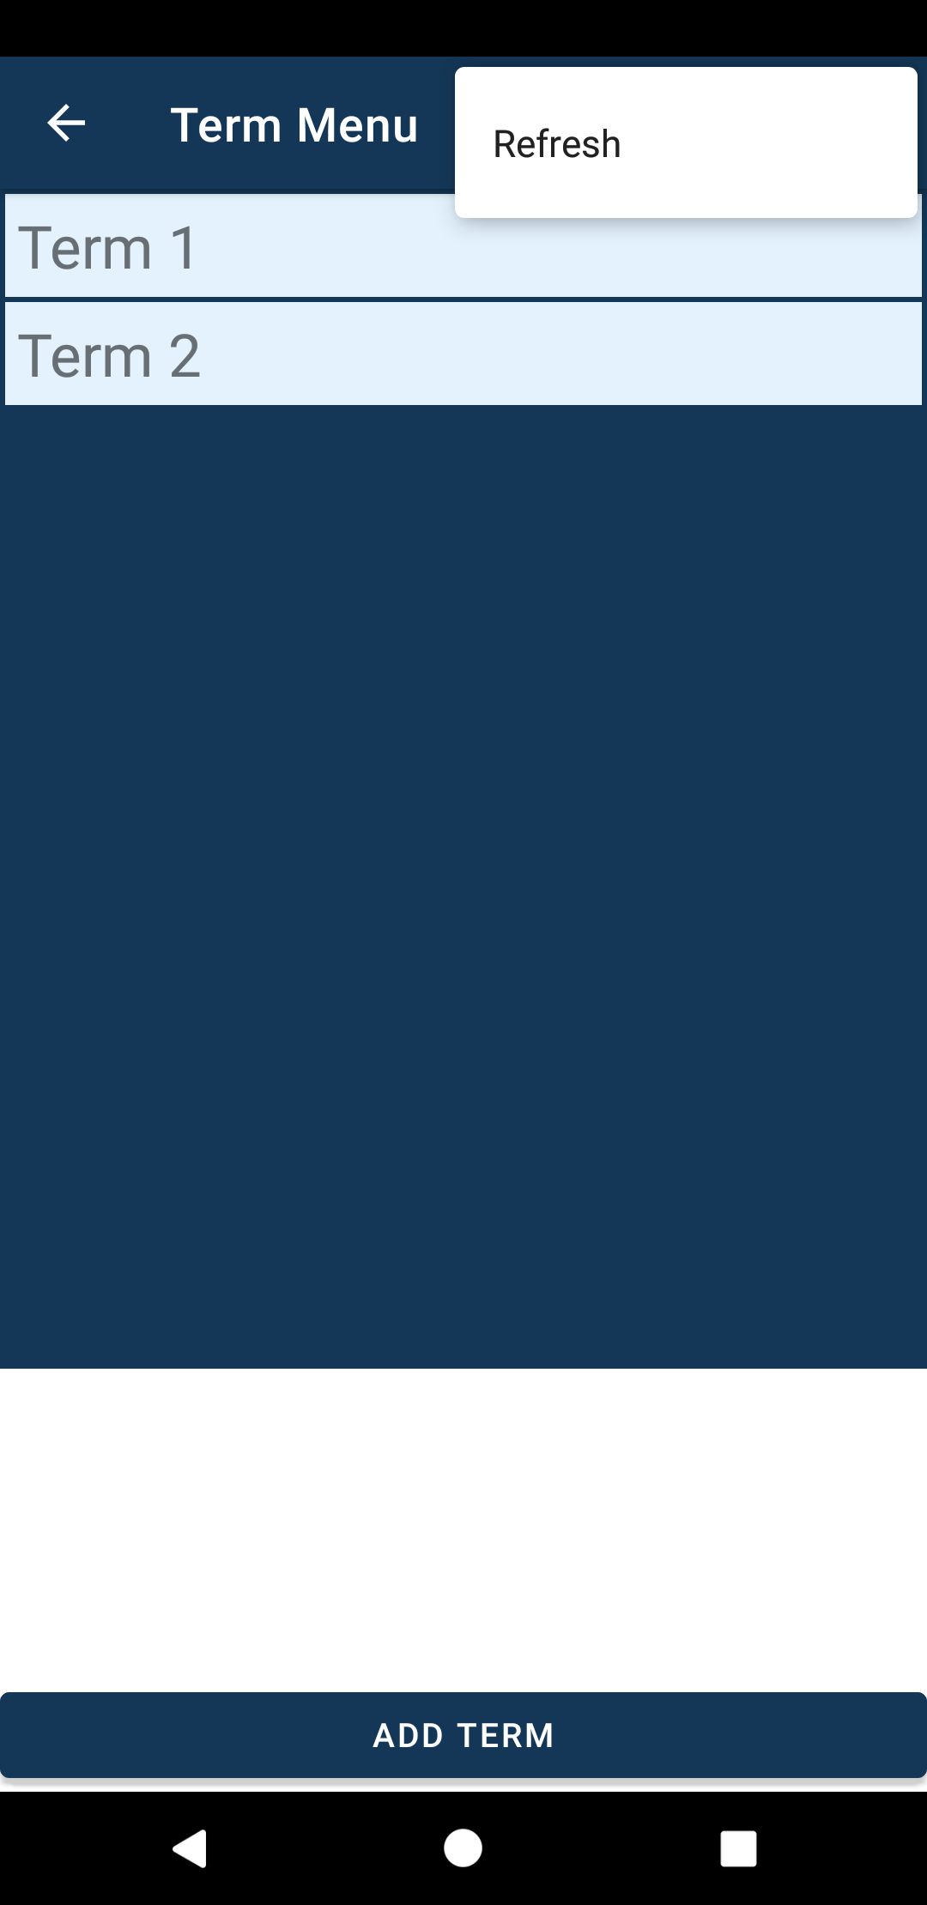
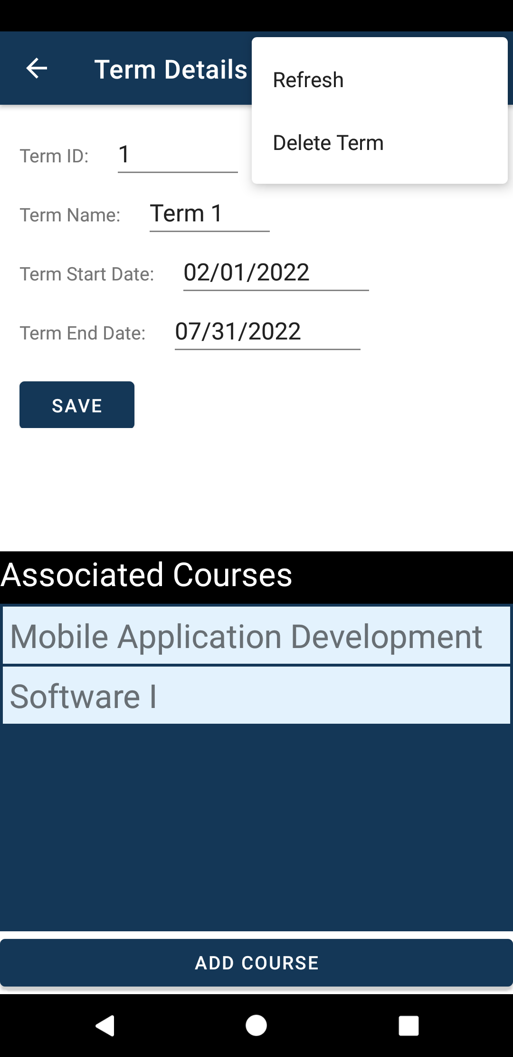
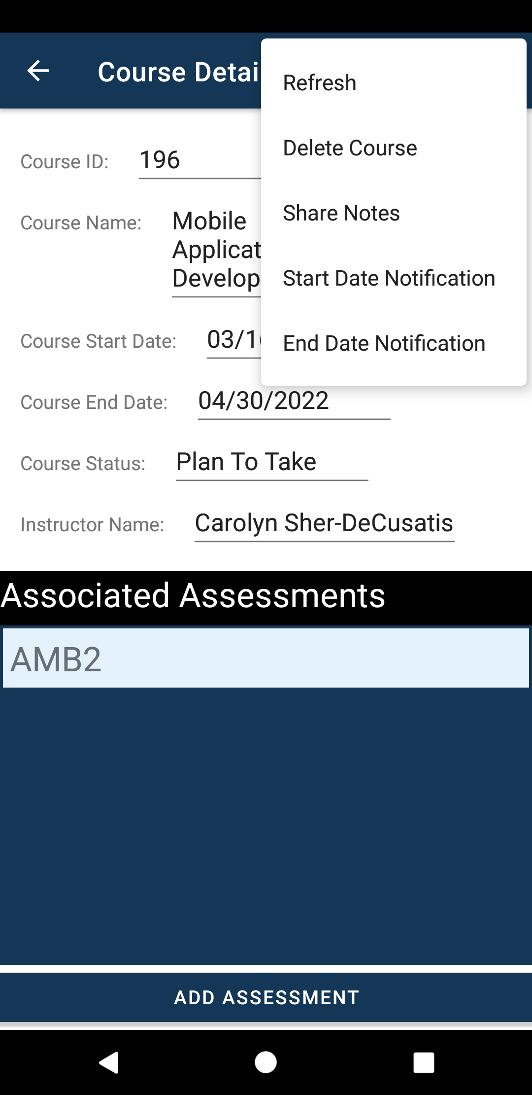
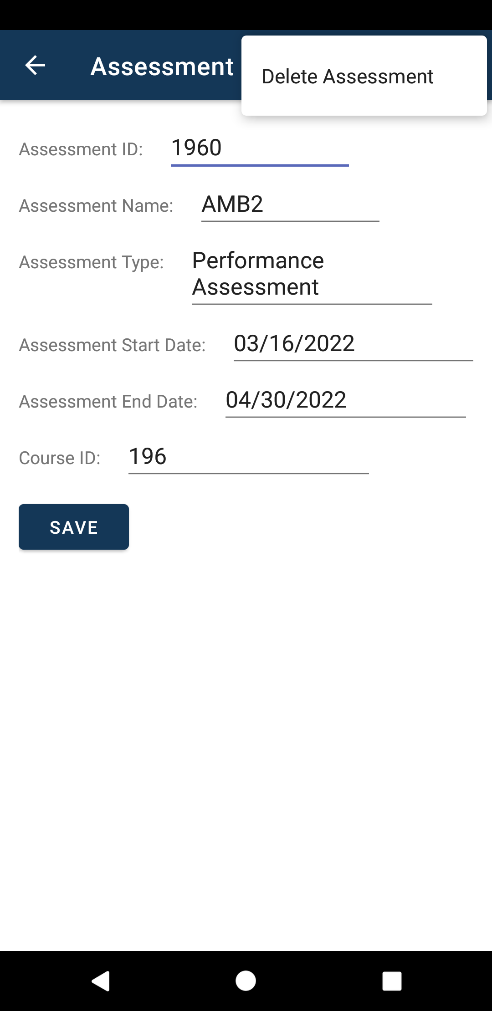
Storyboard cont. - menus
Refresh, Delete Course, Share Course Notes, Set Start/End Date Notifications functionality
Action bar menu opens to Refresh functionality
Refresh and Delete Term functionality
Delete Assessment functionality
All terms screen
All terms screen
Term details screen
Course details screen
Assessment details screen

